Slide 1


Slide 2
Seven Principles
Examine Power
Challenge Power
Elevate emotion and embodiment
Rethink binaries and hierarchies
Embrace pluralism
Consider context
Make labor visible

Slide 3
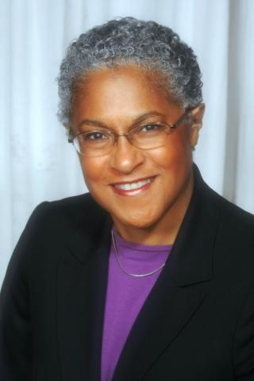
Patricia Hill Collins & Black Feminist Thought (1990)
Matrix of Domination:
Four domains of power
Not only describes systems of power but also how an individual might experience them.

Slide 4
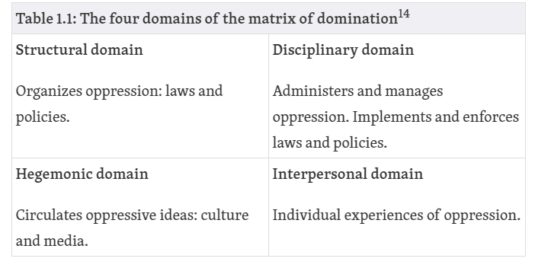
Matrix of Domination

Slide 5
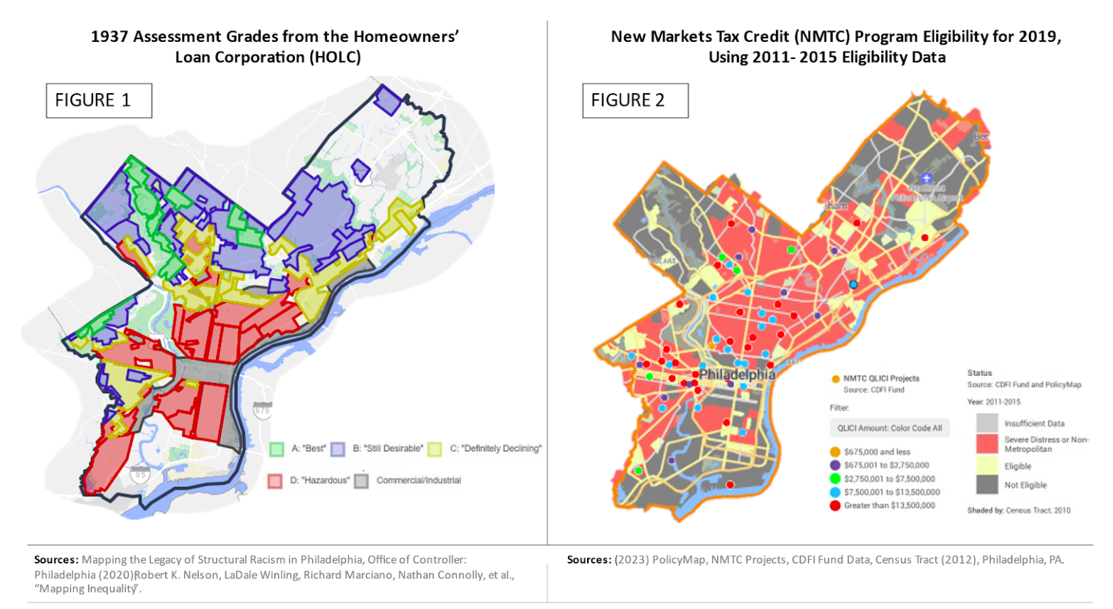
Structural
How A Defunct Policy Is Still Impacting 11 Million People 90 Years Later. https://fas.org/publication/who-loses-redlining-21st-century/

Slide 6
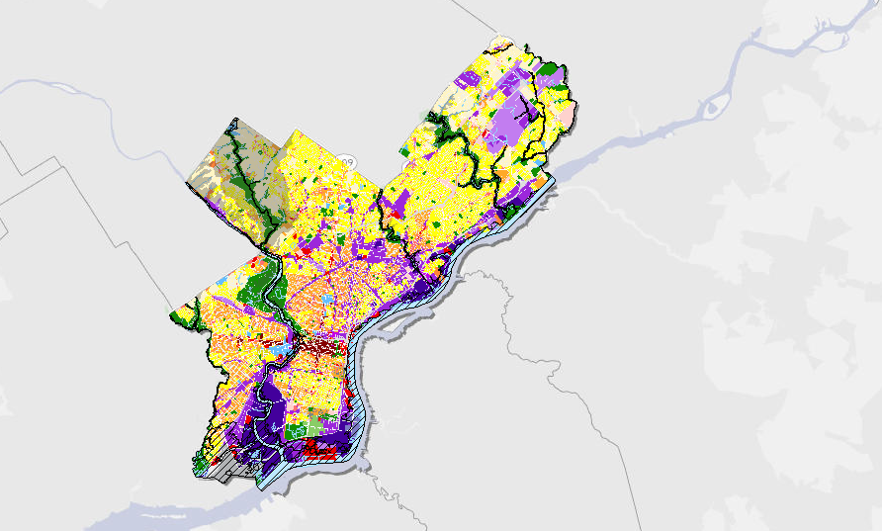

Disciplinary
Zoning Practices
https://whyy.org/articles/council-introduces-end-of-session-zoning-code-changes/

Slide 7
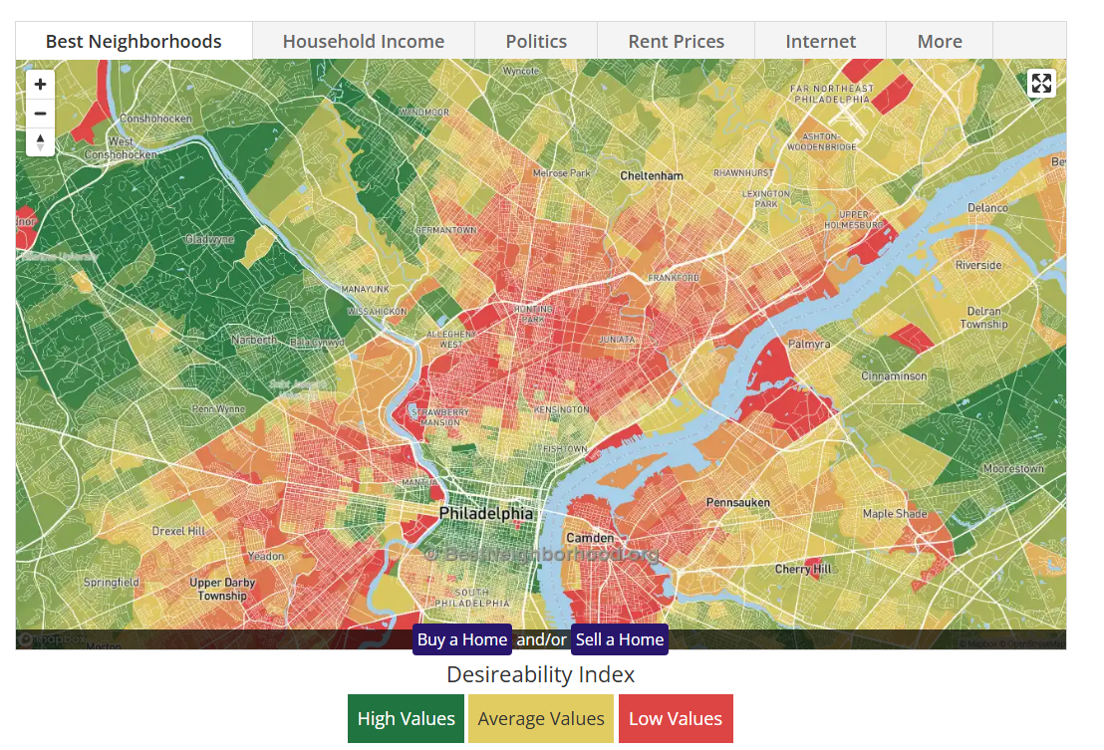
Hegemonic

Slide 8

Interpersonal
https://philadelphia.coop/

Slide 9
Things to Consider
Biased data can mean that some people aren’t being counted. Why would that be?
Is data neutral?
Who does the bulk of data science serve?
Three S’s: Science, Surveillance, and Sales
Privilege Hazard

Slide 10
Matrix of Domination Data Power Analysis

